Slide 1
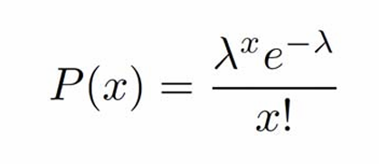
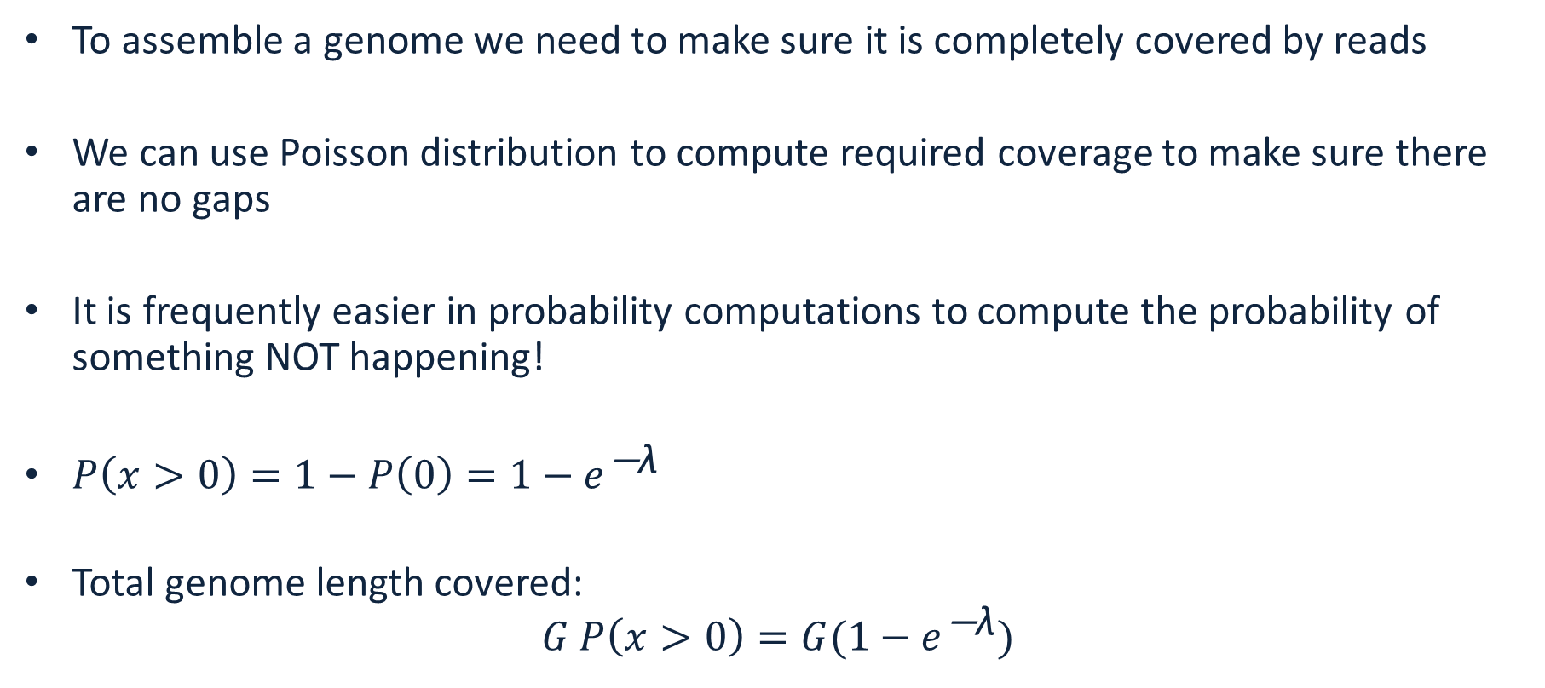
Fraction of the genome covered
To assemble a genome we need to make sure it is completely covered by reads
We can use Poisson distribution to compute required coverage to make sure there are no gaps
It is frequently easier in probability computations to compute the probability of something NOT happening!
${P\left(x>0\right)=1−P\left(0\right)=1−e}^{\text{−}\text{λ}}$
Total genome length covered: ${G P\left(x>0\right)=G(1−e}^{\text{−}\text{λ}})$

Slide 2
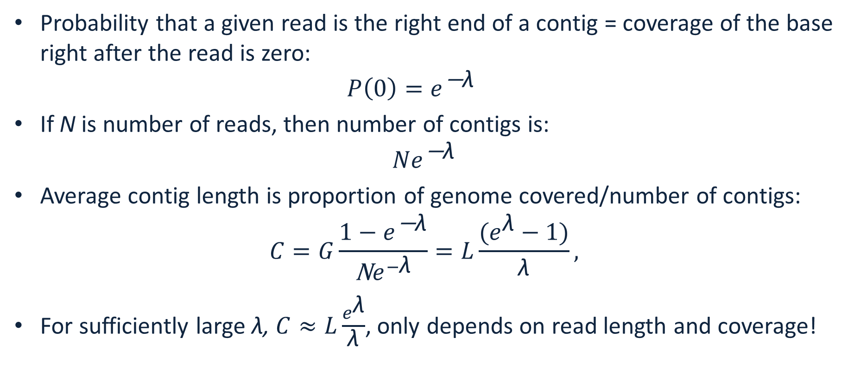
Number of contigs and average length
Probability that a given read is the right end of a contig = coverage of the base right after the read is zero: ${P\left(0\right)=e}^{\text{−}\text{λ}}$
If N is number of reads, then number of contigs is: ${Ne}^{\text{−}\text{λ}}$
Average contig length is proportion of genome covered/number of contigs: $C=G\frac{{1−e}^{\text{−}\text{λ}}}{\text{N}e^{−\text{λ}}}=L\frac{(e^{\text{λ}}−1)}{\text{λ}},$
For sufficiently large λ, $C≈L\frac{e^{\text{λ}}}{\text{λ}}$, only depends on read length and coverage!

Slide 3
Genome is fully covered. Can this be assembled?
1 bp overlap
0 bp overlap
1 bp overlap

Slide 4
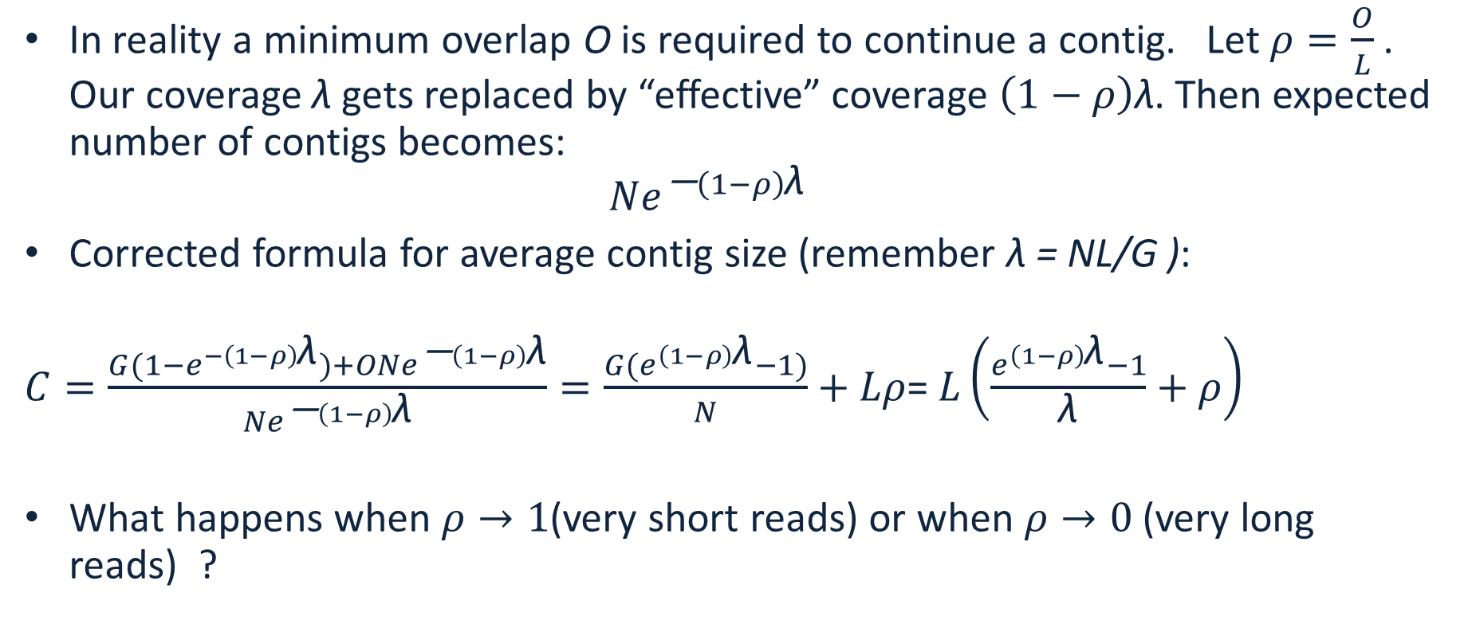
Real life correction to contig length
In reality a minimum overlap O is required to continue a contig. Let $ρ=\frac{O}{L}$. Our coverage $\text{λ}$gets replaced by “effective” coverage $\left(1−ρ\right)\text{λ}$. Then expected number of contigs becomes: ${Ne}^{\text{−}\left(1−ρ\right)\text{λ}}$
Corrected formula for average contig size (remember λ = NL/G ):
$C=\frac{{G(1−e}^{−\left(1−ρ\right)\text{λ}})+O{Ne}^{\text{−}\left(1−ρ\right)\text{λ}}}{{Ne}^{\text{−}\left(1−ρ\right)\text{λ}}}=\frac{{G(e}^{\left(1−ρ\right)\text{λ}}−1)}{N}+Lρ$= $L\left(\frac{e^{\left(1−ρ\right)\text{λ}}−1}{\text{λ}}+ρ\right)$
What happens when $ρ→1$(very short reads) or when $ρ→0$ (very long reads) ?

Slide 5
Reads are Strings
String S is a finite sequence of characters from an alphabet
DNA alphabet is {A,C,G,T}
Substring of S is a string occurring inside S: AGTGACATAAGACT
Prefix of S is a string starting at the beginning of S: AGTGACATAAGACT
Suffix of a string is a string ending at the end of S: AGTGACATAAGACT

Slide 6
Exact matching
Find exact matches of two strings: T: ATGATATGACATAGAC and P: ATGAC
Naïve: check every position: T:ATGATATGACATAGAC P:ATGAC
Boyer-Moore bad character rule, skip pointless alignments:
consider the character in T at which the comparison process failed (assuming such a failure occurred).
Find the next occurrence of that character to the left in P
Propose a shift which brings that occurrence in line with the mismatched occurrence in T.
If the mismatched character does not occur to the left in P, a shift is proposed that moves the entirety of P past the point of mismatch.

Slide 7
Exact matching
Boyer-Moore bad character rule, skip pointless alignments: T:ATGATATGACATAGAC P:ATGAC check last character – if no match skip to the first occurrence, aligning the T T:ATGATATGACATAGAC P:ATGAC P:ATGAC P:ATGAC P:ATGAC P:ATGAC P:ATGAC P:ATGAC

Slide 8
What is an alignment (overlap)?
An alignment does not need to be an exact match
Given:
– a pair of strings
– a method for scoring a candidate alignment
Do:
– determine the correspondences between substrings in the sequences such that the similarity score is maximized

Slide 9
Example of an alignment (overlap)
Alignment of two DNA sequences
AGCGAACGCTGAACGCTAGACCG
and
GCGATCGATGAAGCTAGACTCGT
is
AGCGAACGCTGAACGCTAGAC-CG
|||| || ||||*|||||||*|| GCGATCGATGAA-GCTAGACTCGT

Slide 10
Types of mis-matches
Substitutions: AAGT vs ATGT
Deletions: AAGT vs ATT
Insertions: AAGT vs AAGCT

Slide 11
Smith-Waterman alignment
Published by M.S Waterman; T.F Smith; W.A Beyer (1976)
Local sequence alignment
Fairly expensive: for sequences of lengths m and n is of order O(mn)
Dynamic programming: solve many local problems to then solve the big problem

Slide 12
Smith-Waterman alignment
Align sequences: TGTTACGG and GGTTGACTA
Choose match score s(a,b)=3 if a=b, s(a,b)=-3 if a!=b
Choose gap penalty G=2
Initialize top row and the first column with zeros
 |  | T | G | T | T | A | C | G | G
 | 0 | 0 | 0 | 0 | 0 | 0 | 0 | 0 | 0
G | 0
G | 0
T | 0
T | 0
G | 0
A | 0
C | 0
T | 0
A | 0

Slide 13
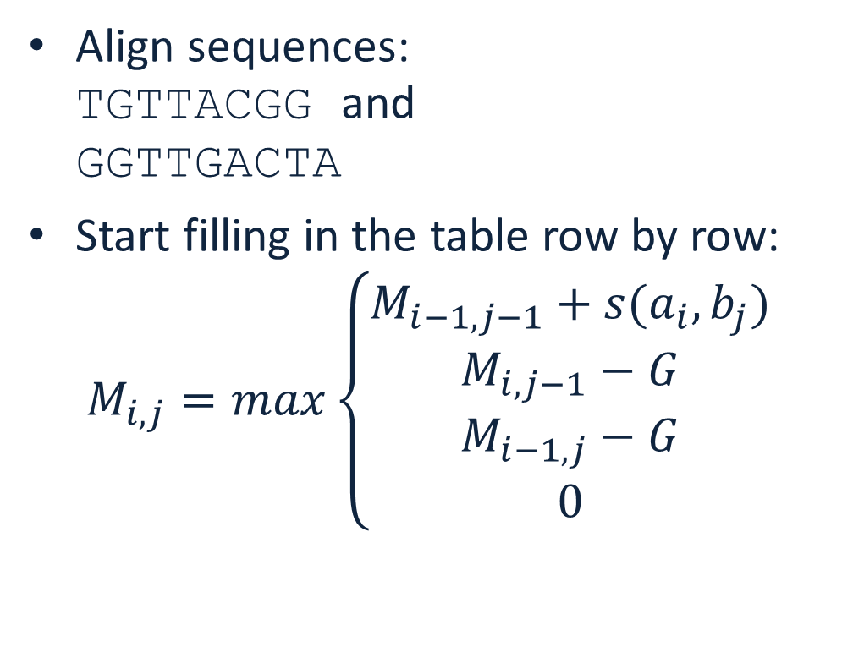
Smith-Waterman alignment
Align sequences: TGTTACGG and GGTTGACTA
Start filling in the table row by row: $M_{i,j}=max\left\{\begin{matrix}M_{i−1,j−1}+s(a_{i},b_{j}) \\ M_{i,j−1}−G \\ \begin{matrix}M_{i−1,j}−G \\ 0\end{matrix}\end{matrix}\right.$
 |  | T | G | T | T | A | C | G | G
 | 0 | 0 | 0 | 0 | 0 | 0 | 0 | 0 | 0
G | 0
G | 0
T | 0
T | 0
G | 0
A | 0
C | 0
T | 0
A | 0

Slide 14
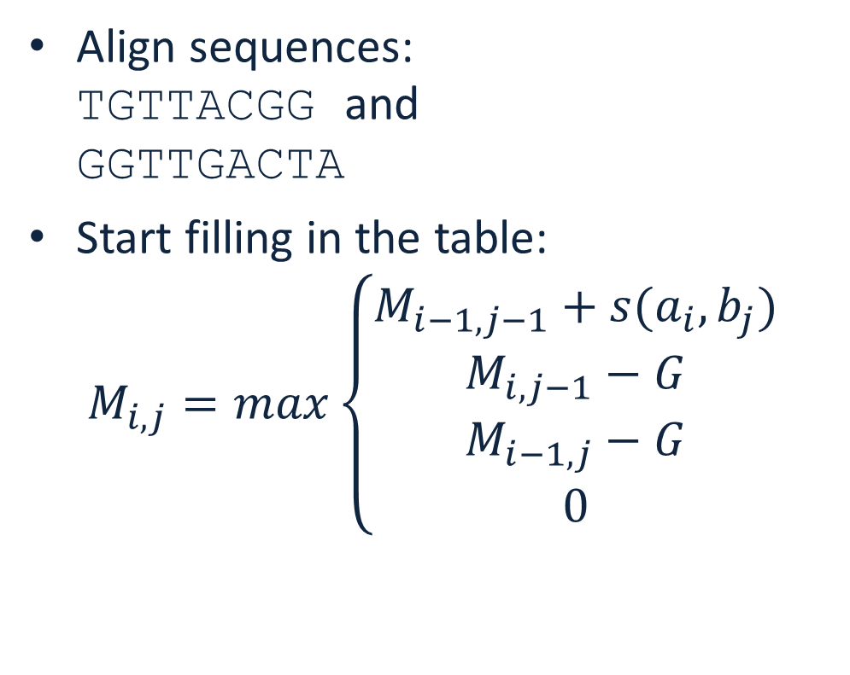
Smith-Waterman alignment
Align sequences: TGTTACGG and GGTTGACTA
Start filling in the table: $M_{i,j}=max\left\{\begin{matrix}M_{i−1,j−1}+s(a_{i},b_{j}) \\ M_{i,j−1}−G \\ \begin{matrix}M_{i−1,j}−G \\ 0\end{matrix}\end{matrix}\right.$
 |  | T | G | T | T | A | C | G | G
 | 0 | 0 | 0 | 0 | 0 | 0 | 0 | 0 | 0
G | 0 | 0 | 3 | 1 | 0 | 0 | 0 | 3 | 3
G | 0
T | 0
T | 0
G | 0
A | 0
C | 0
T | 0
A | 0

Slide 15
Smith-Waterman alignment
Align sequences: TGTTACGG and GGTTGACTA
Start filling in the table: $M_{i,j}=max\left\{\begin{matrix}M_{i−1,j−1}+s(a_{i},b_{j}) \\ M_{i,j−1}−G \\ \begin{matrix}M_{i−1,j}−G \\ 0\end{matrix}\end{matrix}\right.$
 |  | T | G | T | T | A | C | G | G
 | 0 | 0 | 0 | 0 | 0 | 0 | 0 | 0 | 0
G | 0 | 0 | 3 | 1 | 0 | 0 | 0 | 3 | 3
G | 0 | 0 | 3 | 1 | 0 | 0 | 0 | 3 | 6
T | 0
T | 0
G | 0
A | 0
C | 0
T | 0
A | 0

Slide 16
Smith-Waterman alignment
Align sequences: TGTTACGG and GGTTGACTA
Start filling in the table: $M_{i,j}=max\left\{\begin{matrix}M_{i−1,j−1}+s(a_{i},b_{j}) \\ M_{i,j−1}−G \\ \begin{matrix}M_{i−1,j}−G \\ 0\end{matrix}\end{matrix}\right.$
 |  | T | G | T | T | A | C | G | G
 | 0 | 0 | 0 | 0 | 0 | 0 | 0 | 0 | 0
G | 0 | 0 | 3 | 1 | 0 | 0 | 0 | 3 | 3
G | 0 | 0 | 3 | 1 | 0 | 0 | 0 | 3 | 6
T | 0 | 3 | 1 | 6 | 4 | 2 | 0 | 1 | 4
T | 0
G | 0
A | 0
C | 0
T | 0
A | 0

Slide 17
Smith-Waterman alignment
Align sequences: TGTTACGG and GGTTGACTA
Start filling in the table: $M_{i,j}=max\left\{\begin{matrix}M_{i−1,j−1}+s(a_{i},b_{j}) \\ M_{i,j−1}−G \\ \begin{matrix}M_{i−1,j}−G \\ 0\end{matrix}\end{matrix}\right.$
 |  | T | G | T | T | A | C | G | G
 | 0 | 0 | 0 | 0 | 0 | 0 | 0 | 0 | 0
G | 0 | 0 | 3 | 1 | 0 | 0 | 0 | 3 | 3
G | 0 | 0 | 3 | 1 | 0 | 0 | 0 | 3 | 6
T | 0 | 3 | 1 | 6 | 4 | 2 | 0 | 1 | 4
T | 0 | 3 | 1 | 4 | 9 | 7 | 5 | 3 | 2
G | 0 | 1 | 6 | 4 | 7 | 6 | 4 | 8 | 6
A | 0 | 0 | 4 | 3 | 5 | 10 | 8 | 6 | 5
C | 0 | 0 | 2 | 1 | 3 | 8 | 13 | 11 | 9
T | 0 | 3 | 1 | 5 | 4 | 6 | 11 | 10 | 8
A | 0 | 1 | 0 | 3 | 2 | 7 | 9 | 8 | 7

Slide 18
Smith-Waterman alignment
Align sequences: TGTTACGG and GGTTGACTA
Pick the cell with the highest score
Traceback exploring all return paths of the same score
at every step choose the highest score
stop at 0
 |  | T | G | T | T | A | C | G | G
 | 0 | 0 | 0 | 0 | 0 | 0 | 0 | 0 | 0
G | 0 | 0 | 3 | 1 | 0 | 0 | 0 | 3 | 3
G | 0 | 0 | 3 | 1 | 0 | 0 | 0 | 3 | 6
T | 0 | 3 | 1 | 6 | 4 | 2 | 0 | 1 | 4
T | 0 | 3 | 1 | 4 | 9 | 7 | 5 | 3 | 2
G | 0 | 1 | 6 | 4 | 7 | 6 | 4 | 8 | 6
A | 0 | 0 | 4 | 3 | 5 | 10 | 8 | 6 | 5
C | 0 | 0 | 2 | 1 | 3 | 8 | 13 | 11 | 9
T | 0 | 3 | 1 | 5 | 4 | 6 | 11 | 10 | 8
A | 0 | 1 | 0 | 3 | 2 | 7 | 9 | 8 | 7

Slide 19
Smith-Waterman alignment
Align sequences: TGTTACGG and GGTTGACTA
Alignment result: TGTT-ACGG ||| || GGTTGACTA
 |  | T | G | T | T | A | C | G | G
 | 0 | 0 | 0 | 0 | 0 | 0 | 0 | 0 | 0
G | 0 | 0 | 3 | 1 | 0 | 0 | 0 | 3 | 3
G | 0 | 0 | 3 | 1 | 0 | 0 | 0 | 3 | 6
T | 0 | 3 | 1 | 6 | 4 | 2 | 0 | 1 | 4
T | 0 | 3 | 1 | 4 | 9 | 7 | 5 | 3 | 2
G | 0 | 1 | 6 | 4 | 7 | 6 | 4 | 8 | 6
A | 0 | 0 | 4 | 3 | 5 | 10 | 8 | 6 | 5
C | 0 | 0 | 2 | 1 | 3 | 8 | 13 | 11 | 9
T | 0 | 3 | 1 | 5 | 4 | 6 | 11 | 10 | 8
A | 0 | 1 | 0 | 3 | 2 | 7 | 9 | 8 | 7

